Slide 1

CSG1105 / CSG5130
Applied Communications
Chapter 8
The TCP/IP Protocols

Slide 2
Objectives
Describe how the TCP/IP protocol stack is organized compared to the ISO/OSI protocol stack
Discuss the different protocols that make up the TCP/IP suite
  Includes IP, TCP, UDP, ARP, and RARP, as well as support protocols DNS, BOOTP, TFTP, DHCP, ICMP, SMTP, HTTP, HTTPS, and NTP
Show how TCP/IP data are encapsulated inside a hardware frame for transmission

Slide 3
Objectives (cont’d.)
Describe the relationship between IP addresses and MAC addresses
Discuss the role of the PING, TRACERT, NBTSTAT, and NETSTAT applications
Explain the new features provided by IPv6
Describe the purpose and use of a protocol analyzer

Slide 4
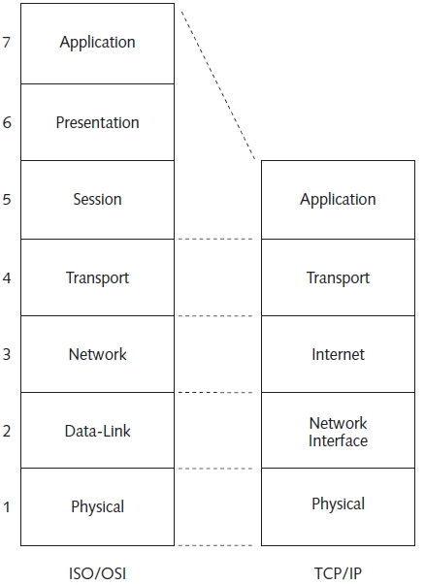
Introduction
TCP/IP network model contains five layers
Figure 8-1 ISO/OSI and TCP/IP protocol stacks

Slide 5
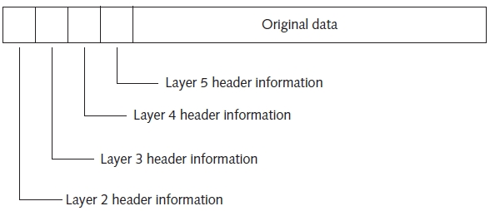
Introduction (cont’d.)
Data packet transmitted from source computer
  Contains an informational header for each layer
Figure 8-2 TCP/IP stack layering

Slide 6
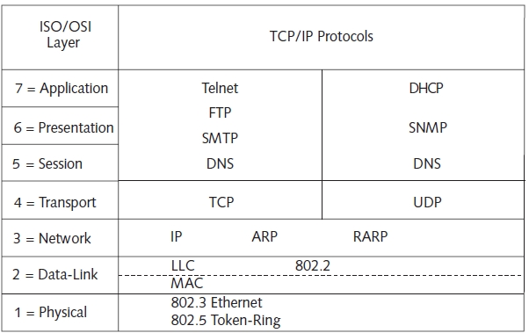
Introduction (cont’d.)
TCP/IP supports many protocols
Figure 8-4 TCP/IP protocol suite

Slide 7
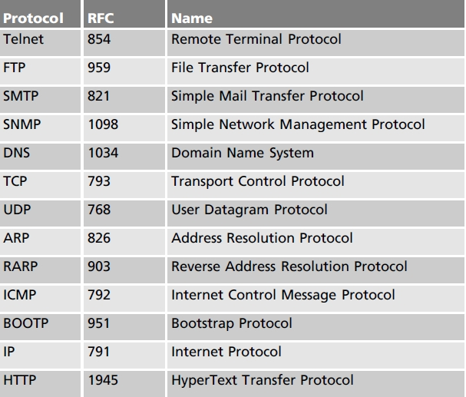
RFCs
Describe TCP/IP protocols in detail
Official Internet standards
  Published as electronic documents
Table 8-2 Several important TCP/IP RFCs

Slide 8
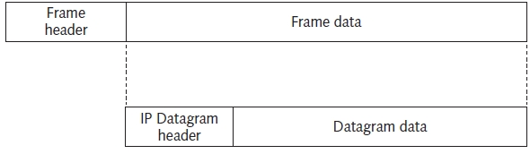
IP
TCP/IP protocol suite base layer
  Used at the TCP/IP stack Internet layer
Datagram: unit of packaged TCP/IP data
  Encapsulates all TCP/IP protocols
    Exception: address resolution protocols
  Eventually encapsulated inside a hardware frame
Figure 8-5 An IP datagram encapsulated into an Ethernet frame

Slide 9
IP (cont’d.)
Basic IP datagram transmission
  Source computer sends packets via local LAN
    Forwarded to destination
    Router forwards packet to another router or local LAN computer
  IP datagram pieces treated as independent entities
    May take different routes
    Destination computer may receive packets out of order
IP is unreliable
  Offers best effort delivery
    No guarantees data delivery

Slide 10
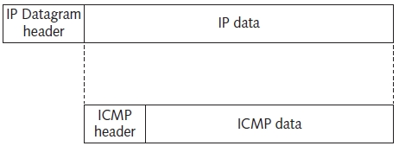
IP (cont’d.)
Congested network
  Datagrams discarded
  ICMP contains error message: may/may not be returned
IP datagram encapsulated in hardware frame
  Uses local network maximum transmission unit (MTU): typically 1500 bytes
  Fragmentation occurs when different MTUs encountered
Figure 8-7 ICMP encapsulated in an IP datagram

Slide 11
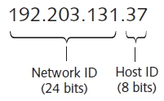
IP Addresses
Routes IP datagram across network
  Uses dotted decimal notation
Assigned by software (statically or dynamically)
  Must be unique
  Differs from MAC addresses
    Fixed 48-bit addresses encoded into Ethernet controller hardware
Figure 8-11 Class C network IP address

Slide 12
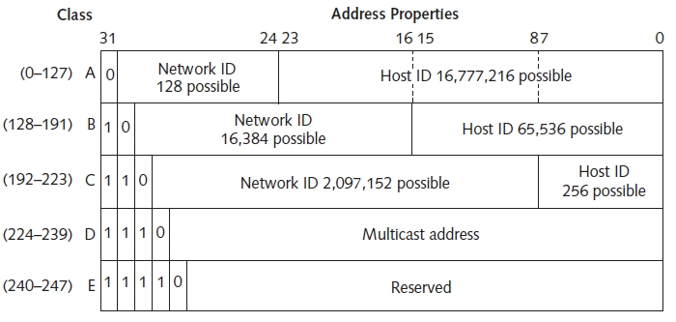
IP Addresses (cont’d.)
Five Internet address classifications
  Each contains a network ID, host ID
Figure 8-12 IP address classes

Slide 13
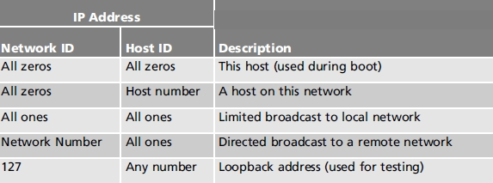
IP Addresses (cont’d.)
Some IP addresses reserved
IP version 4 addressing scheme shortcoming
  Unused hosts in Class A, Class B
  Shortage of all Internet addresses
Table 8-4 Special IP addresses

Slide 14
TCP
Allows two computers to communicate together over interconnected networks
  Connections established through predefined ports, sockets
    Reliable, error checking, packet received acknowledgment, packet sequencing
Provides communication link between application program and IP
  Uses a set of function calls
    Provides application process different options

Slide 15
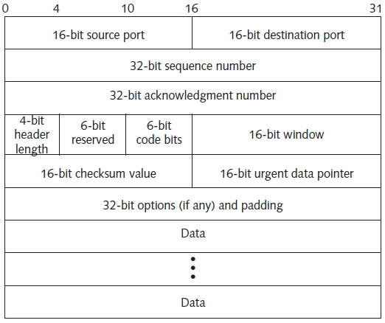
TCP (cont’d.)
TCP header and associated data
  Encapsulated into IP datagram and hardware frame
Figure 8-13 TCP datagram format

Slide 16
TCP (cont’d.)
Primary purpose of TCP
  Provide guaranteed delivery on top of IP
  Areas requiring attention to guarantee delivery:
    Data transfer, reliability, flow control, multiplexing, connections, message precedence and security
Port numbers
  Data communicated between two TCP applications utilizes specific ports
  Port
    Associated with network socket, used by the application
  Pair of sockets uniquely identify network connection

Slide 17
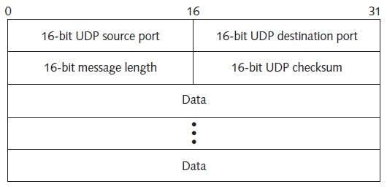
UDP
Connectionless and unreliable
  Many applications do not require TCP handshaking overhead and complexity
    Domain Name Service (DNS), Dynamic Host Configuration Protocol (DHCP), network games
Figure 8-16 UDP datagram format

Slide 18
ARP and RARP
Address Resolution Protocol (ARP)
  Uses a directed broadcast message
    Obtains MAC address for a given IP address
  ARP messages
    Not encapsulated within an IP datagram
    Encapsulated directly into an Ethernet frame
  Not routable
    Locates machines on local network
    Internet traffic forwarded to the default gateway

Slide 19
ARP and RARP (cont’d.)
Reverse Address Resolution Protocol (RARP)
  Provides IP address for a specific MAC address
  RARP message format
    Same as ARP message
ARP application program runs from DOS prompt
  Displays/manages IP/MAC address table

Slide 20
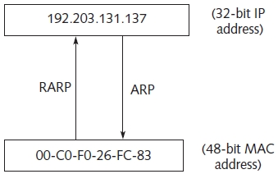
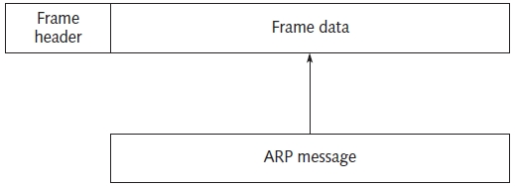
ARP and RARP (cont’d.)
Figure 8-18 ARP message in an
Ethernet frame
Figure 8-19 Using ARP and RARP

Slide 21
TCP/IP Support Protocols
Domain Name Service (DNS)
  Converts host name to IP address (vice versa)
  Makes it easier to remember an address
Bootstrap Protocol (BOOTP)
  Routable UDP protocol
  Allows diskless workstation to:
    Discover its own IP address
    Discover IP address of a BOOTP server
    Specify file to be downloaded (via TFTP) and executed
Trivial FTP: simple file transfer protocol
  Used when user authentication not necessary

Slide 22
TCP/IP Support Protocols (cont’d.)
DHCP
  Dynamically assigns IP addresses to network devices during bootstrap process
    Simplifies network administration
ICMP
  Contains error message for IP datagram error
SMTP
  Routes electronic mail on the Internet using TCP, IP

Slide 23
TCP/IP Support Protocols (cont’d.)
SNMP
  Defines format and meaning of messages exchanged by manager and agents
HTTP
  Transfers multimedia information over the Internet
HTTPS
  Exchanges encrypted Web pages between a client/server connection
NTP
  Synchronizes the time of multiple network computers

Slide 24
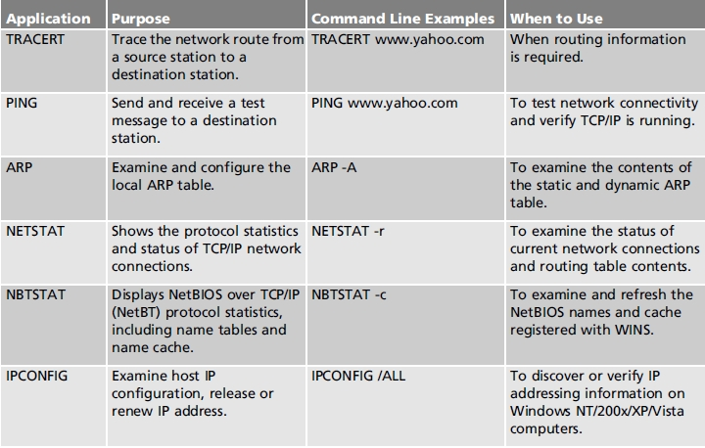
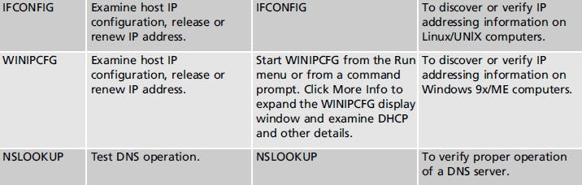
TCP/IP Applications
Table 8-12 Comparison of different network utilities

Slide 25
TCP/IP Applications (cont’d.)
FTP
  Allows users to:
    Log in to a remote computer
    Transfer files back and forth through simple commands
Telnet
  Allows user to:
    Establish remote computer terminal emulation connection

Slide 26
IP Version 6 (IPv6)
Next generation Internet
  Resolves many problems in IPv4
Changes from IPv4
  Address: 128 bits
    Accommodates foreseeable network growth
  Different header formats, new extension headers, support for audio and video
  All possible protocol features not specified
    Allows for adding new features
    No need to update the protocol

Slide 27
IP Version 6 (cont’d.)
IPv6 addresses
  128-bits long, written using colons (:),
  Uses 4-digit groups of hexadecimal numbers
    Hexadecimal group represents 16 bits of binary addressing information
  Shorthand technique eliminate groups of 0000 patterns: double-colon (::)
  Composed of network, host addressing bits
    Subnet mask determines network associated with a specific IP address
    Can attach subnet mask IP address

Slide 28
Protocol Analyzers
Hardware or software devices
  Listen to network traffic
  Capture packets for examination
Double as cable testers

Slide 29
Troubleshooting Techniques
Windows ipconfig utility and Linux ifconfig utility
  Displays various IP address information
Network utilities
  Handy for many reasons
  On the spot troubleshooting
  Can be combined to resolve issues

Slide 30
Summary
TCP/IP protocol model contains five layers
Internet Protocol (IP): TCP/IP base layer
  Provides best effort delivery
  Connectionless communication
TCP/IP data packaged in units called IP datagrams
TCP: reliable and connection oriented
UDP: unreliable and connectionless
ARP and RARP obtain MAC and IP addresses
IPv6 adds addressing improvements to IPv4
Many protocols and tools available

